Slide 1
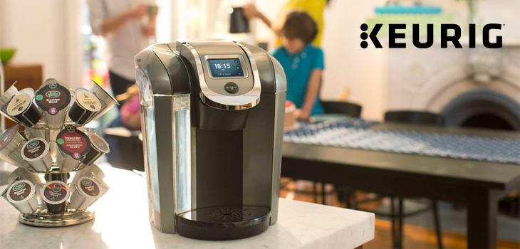
Reaching Offices & Home with Precisely Engineered Machines & Gourmet Coffee
Rajiv Rai
Presentation for IE 590-Structured Engineering Innovation
Master’s Student IE
Notes:
Coffee improves your performance when working out
Caffeine increases your levels of adrenaline, and releases fatty acids from fat tissues, leading to a better physical performance .
Coffee contains lots of antioxidants (it's the biggest source of antioxidants in an average Western diet!). As a result, coffee drinkers are at a lower risk of diseases such as Parkinson’s Disease, Type II Diabetes, and Heart Disease.
Your body naturally produces a hormone called cortisol that helps you feel alert and awake. That is released according to your circadian rhythm, dictated by the time of the day. So, if you have a habit of drinking coffee when you first wake up, you may want to wait a bit longer so that your caffeine isn’t wasted during a time when cortisol is at its highest.

Slide 2

Index
Company Overview
Company history, timeline, awards & recognitions
Dr. Richard Liu’s Hierarchical Value Chain and its importance in innovation
Relationship matrix for innovation
List of innovations : total 4
Market Strategies explained with Ohmae’s 3C’s
Keurig Economics
Porter 5 forces analysis & its importance in innovation
Future strategic considerations
References
Mission Statement:
A Keurig® brewer on every counter and a beverage for every occasion.
Vision:
Become the world’s leading personal beverage systems company.
Notes:
We partner for mutual success
Our boundaryless approach to collaboration creates benefits for all. We innovate with passion
With courage and curiosity, we are shaping the future by redefining the customer experience. We play to win
Our team sets ambitious goals and meets each challenge with unified purpose and character. We brew a better world
We use the power of business to make the world a better place.

Slide 3
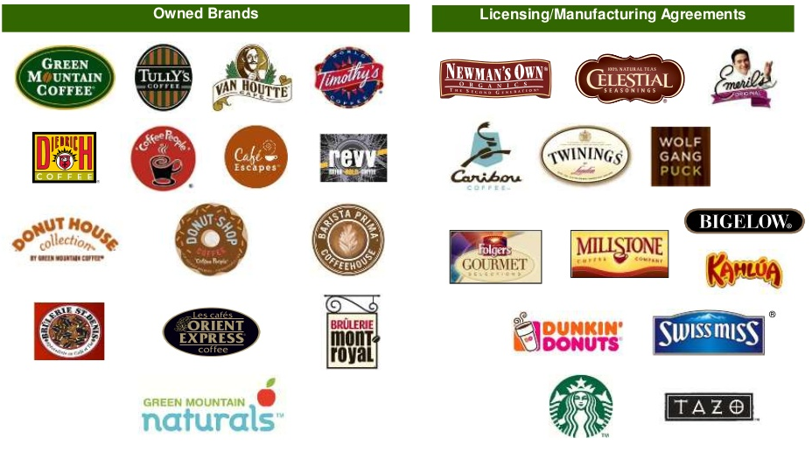
Company Overview
Keurig Green Mountain has partnered with, more than 50 leading global coffee, tea and cocoa brands to offer consumers vast personal choice from 500+ varieties. Its HQ in Vermont and is committed to using the power of business to brew a better world through resilient supply chains, sustainable products, and thriving communities.
It patented its innovative single cup brewing system in 1998, which solved the commonplace problem of office coffee – provide a single-serving pod of coffee grounds and a machine that would brew fresh coffee consistently instead of a full pot of brewed coffee which sits and grows bitter, dense, and stale.
Keurig Green Mountain on Forbes Lists #43 Innovative Companies, 2015
#2 in 2014 Midsized Growth Leader in U.S in Consumer Packaged Goods
#14 Among the Top 100 Green Companies in U.S.A 2015
2nd fastest growing business in manufacturing category according to Vermont Business Magazine in 2014
#48 among FORTUNE Fastest Growing Companies in 2015
#1 Best Coffee Roaster in Vermont in 7 Daisy Awards

Slide 4

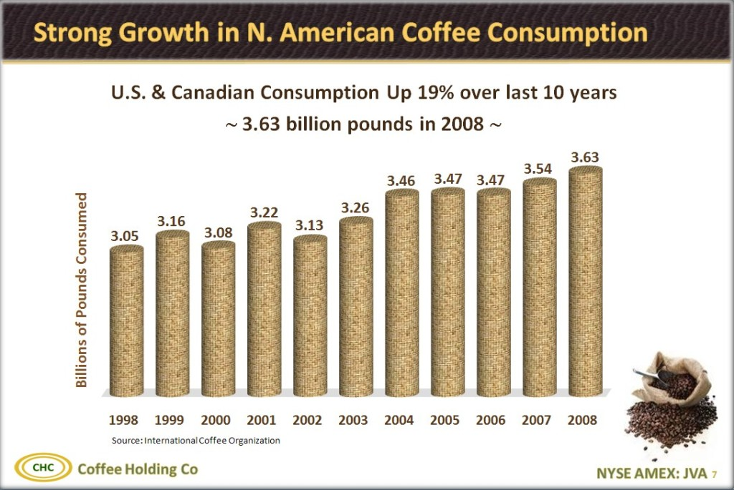
Keurig Time Line
1991 2016
2015-16 enters soda market with Coca Cola, invents system 2.0, recyclable K-Cups
2012-15 Agr. with Soup & Noodle Companies for K-Cup Use
2009 Agr. With Starbucks & Dunkin Donuts
1998-2006 Acquisition & License Agreements
1997 Invents K-Cups & Keurig One Cup System
1993 GMCR Invests in Single Brewing Keurig

Slide 5
Company Background
Keurig (Dutch Translation of Faultless)
In 1993, Keurig had approached GMCR( Green Mountain Coffee Roasters) about developing a single-cup coffee brewing system, they were the first investors in the nascent company.
In 1997, Green Mountain Coffee Roasters became the first roaster to offer coffee in a K-Cup pod for the Keurig Single-Cup Brewing System,
In 1998 Keurig delivered its first brewing system, designed for office use. The launch of the first K-Cups with Green Mountain Coffee helped GMCR begin to further compete with the ubiquitous presence of Starbucks, by allowing people to brew their own single servings of premium coffee.
From 1999 – 2006 acquisition licensees, Tully's Coffee, Timothy's World Coffee, Diedrich Coffee, and Van Houtte coffee brands.
In 2009 agreement with huge brands like Dunkin Donuts & Starbucks to sell their ground coffee beans in K-Cups
In 2014, Keurig Green Mountain introduced the advanced Keurig 2.0 brewer,
In March 2015, agreement with General Electric who announced refrigerators with fitted Keurig. Also, Keurig launched a line of Campbell's Soup(Chicken Noodle and Southwest Style Chicken Noodle )available in K-Cups.
The machine brews beverages from The Coca-Cola Company and the Dr Pepper Snapple Group, in addition to Keurig's own line of flavored sparkling and non-sparkling waters and teas, sports drinks, and soda-fountain drinks.

Slide 6
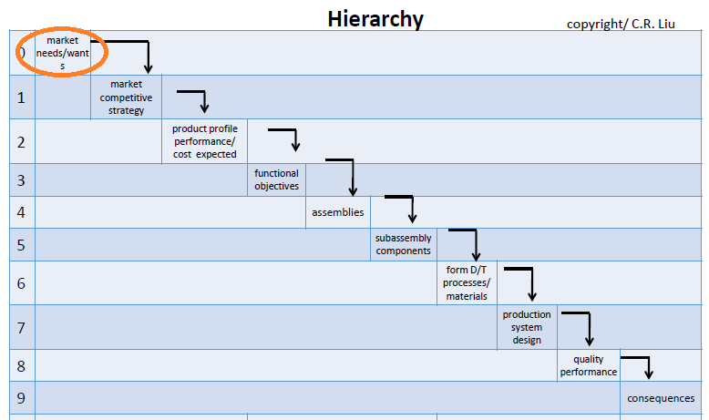
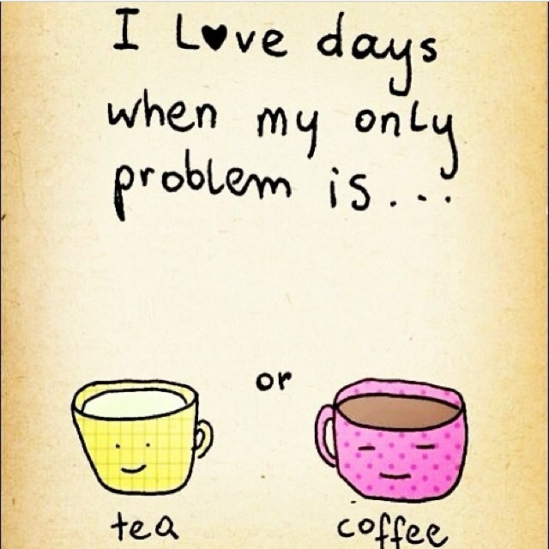
Problems in Regular Coffee Machine System – The Drip Coffee Maker
( Market Needs )
Costly Varieties of Gourmet Coffee
Difficulty in Obtaining Gourmet Coffee in Regular Market ( like Ethipoian Coffee)
Low Shelf Life of Coffee
Quality deterioration of Regular Coffee Brewing m/c
Long queue waiting times of popular coffee shops like Starbucks
Inconsistent taste
Inability to decide the strength, quantity and temperature of brewing
Inconvenience: early rising and carrying the coffee in a cup causing spillage
Lunch hours spent on waiting in long coffee shop queues
Coffee farmers migrating to cities from insufficient income security

Slide 7
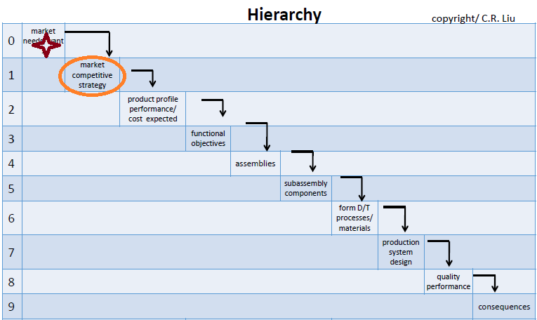

Keurig’s Market Competitive Strategy
Part 1:
For Product : Keurig K-Cups & Keurig Home/Office Brewers
Strategy : Focus on ‘Single Cup Systems’ but continually differentiate with innovations
Reason : Potentially two cups can confuse users whether machine has finished dispensing or would later
For Product: Prepare different checkpoints within office coffee services(OCS)
Strategy : Focus on distinct concepts for home market, and not just different packaging – continually innovate in
both fields
Reason: By making the price of existing K-Cup at home be same as one of OCS market, will protect Keurig Authorized Distributors(KAD’s) revenues by ‘locking the deal’ with office managers. Fixed Price.
Part 2:

Slide 8
Keurig Brewers
With Water Reservoir
Without Water Reservoir
Model K10/B10 Mini Plus
Programmable
No
Water Filter
Yes
Yes
No
Keurig 2.0, K350, K450, K 550
Program Auto On/Off
Optional Water filter included
Hot water Dispense
Multiple Cup Sizes
Keurig K155
Program Auto On/Off
Optional Water filter included
Can be plumbed into direct water line
Accepts 3rd party reusable filters
K 45 Keurig Elite
Accepts My K Cup & 3rd party reusable filters
48 ounce water reservoir
3 cup sizes
K 145
Household & commercial
Accepts My K Cup & 3rd party reusable filters
Differentiating its products with more services

Slide 9
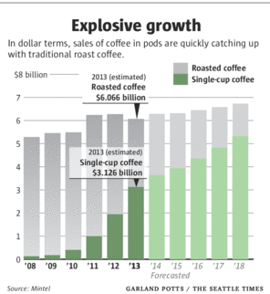
Keurig’s Market Competitive Strategy
Part 3:
For Brewer : market skimming for the brewer
Strategy : Focus on premium market at first and then penetrate it with mid-price.
Reason : Target core users (office goers)
Premium launching for $299 : speedy to use, faster dispensing , convenience of self clean-up.
Benefits:
Less price sensitive segment
Definite value proposition
Profitable pricing and market skimming
Basic launching for $130 : not competing Nespresso which costs $250
Benefits:
Market penetration at a low price outstripping the competitors with lowest cost
Lower than the amount spent on Starbucks daily for a month

Slide 10
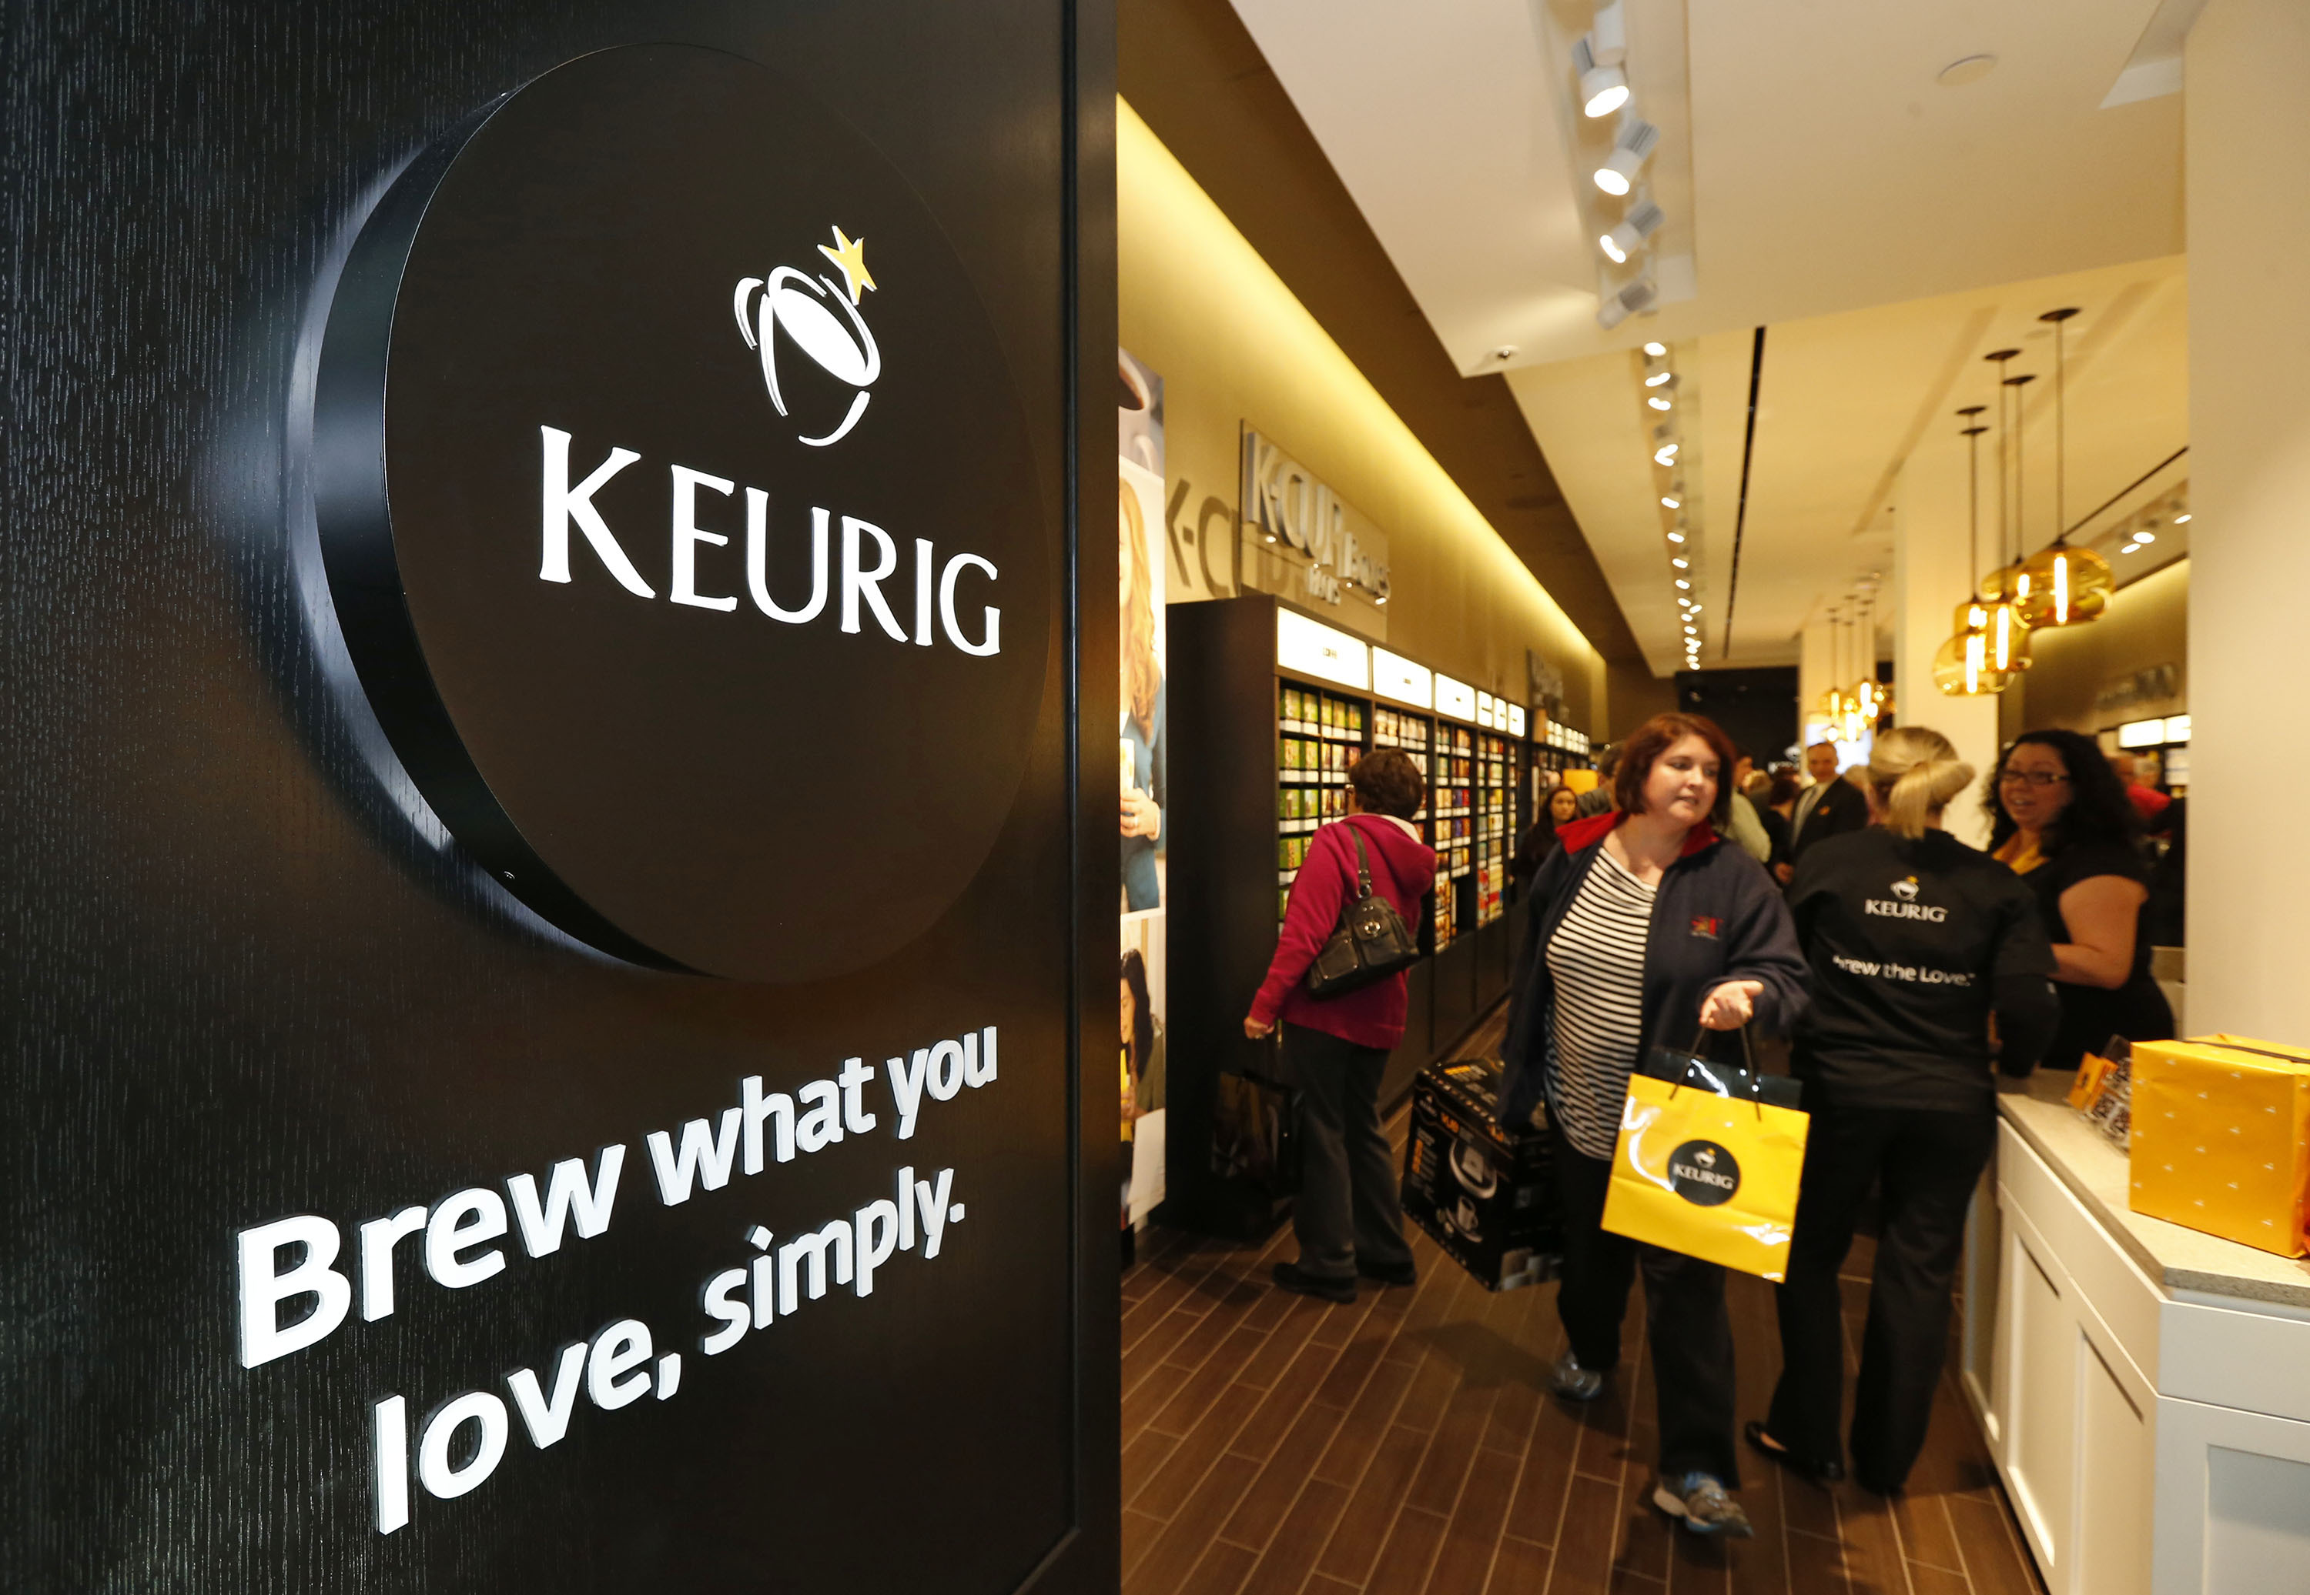
Keurig’s Market Competitive Strategy
Part 4:
For Marketing: direct marketing through e-commerce & traditional retail demonstrations
Short Term
Strategy : Direct marketing by e-commerce to increase brand awareness through online advertising
Reason : to sell the brewers & K-Cup together and spend less money on controlling distributors.
Long Term
Strategy :develop traditional retail store and conduct in-house, mall , grocery store demonstrations to spread awareness
Reason :to expand market share online selling is not enough, building trust on the product
Product Demonstrations
Building A Brand
Word Of Mouth In Offices
E-commerce selling

Slide 11
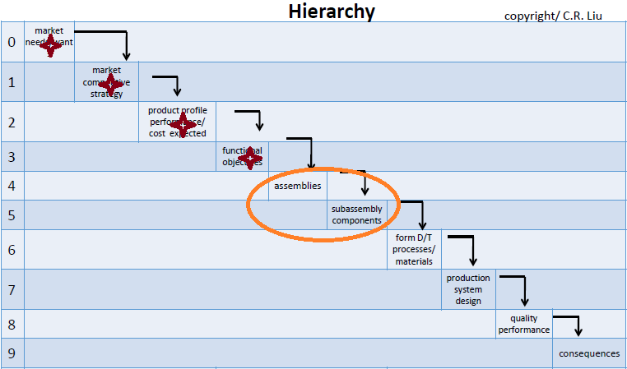
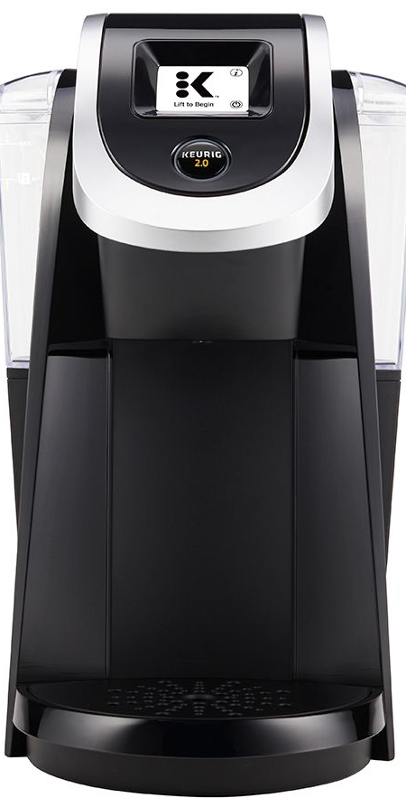
Hypothesis driving innovation
“The best way to have a good idea, is to have lots of ideas “–
Linus Pauling, Biochemist, Nobel Laureate
A single fantastic product generating revenue and increased customer demand gives a company the ‘room’ to test ideas and to increase its span of dominance with improvements in all following aspects related to that industry:
Products,
Packaging,
Supply Chain
Sustainability
Internal Value Chain – employees, skills, infrastructure
It’s impossible to predict what the economic future holds, or more specifically what products or business ideas are going to succeed, and so the company must make continuous improvements in all areas and derive a set of strategic principles which internally leverage strengths and externally capture opportunities to create profits.
.

Slide 12
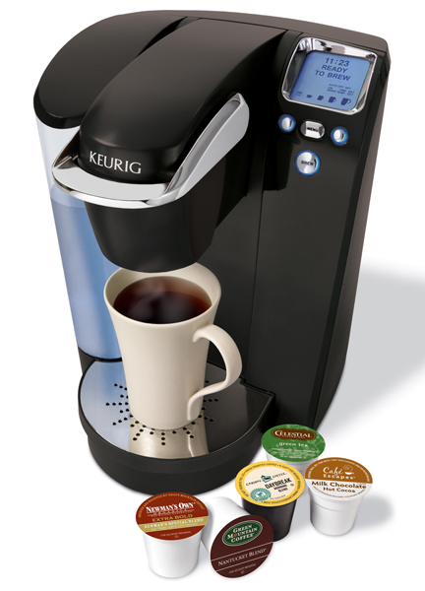

Relationship Matrix Hypothesis of Innovation Creation due to
Products Keurig K-Cup Brewing Systems with Microprocessor Controlled Technology Airtight Coffee Pods K-Cups | Structure
 | Primary Value Chain: Do-it within: Inbound logistics: licensing relationships with coffee market players, coffee bean growers, brewing machine parts suppliers. Outbound logistics: Expanded distribution for continual global demand Marketing/Sales Push: multi-channel distribution-grocery stores, specialty food stores, office coffee service, convenience & online stores. Secondary Value Chain Do it within: own unique patented technology.
 | Drivers
 | Competition: Rivalry: beverage market is dominated by Starbucks. But market for single brewing machines is currently dominated by KGM in North America. Threats of substitutes: vintage style drip coffee maker, Coffee shops, flavored tea, cocoa, Power of buyers: Customers value high quality products that differentiates itself.
Strategies
Expanding brand offerings, both owned and partner brands, expanding in current channels, & internationally Launching new brewer technologies and innovation; i.e. Keurig 2.0 launched in 2015 with recyclable K-Cup facility Licensing agreements with Unilever North America (Lipton®), Perfect Iced Tea®, Good Earth® Corporation and Tetley®, Snapple Beverages. Starbucks Corporation and Associated British Foods plc
Win All Without Fighting: Capturing Market Without Head On Collision
- Sun Tzu (Art Of War

Slide 13
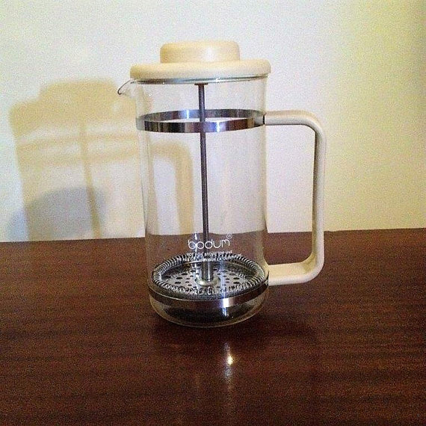
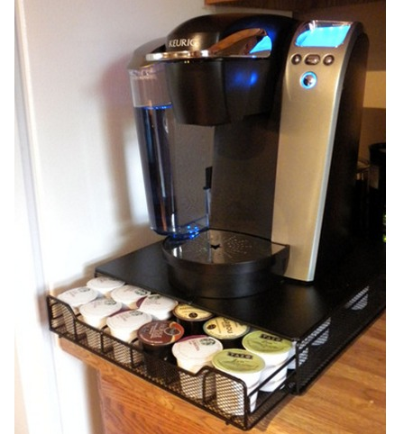
List of Innovations
Innovation 1
Unlike the drip models already on the market, John Sylvan’s(founder of Keurig) machine would brew single cups using sealed capsules of ground coffee.
For the first few years, they drew no salary and were turned down for funding by scores of venture capitalists.
Keurig K-Cup Single Brewing System (1997)
500 varieties of Coffee
Freshness Restored
Sleek Design
‘Descale’ Indicator
Unlimited Hot water
1980 Filter Coffee Machine
Lacked Usability(could not be carried to office)
Brewed only 1 Cup of Coffee
Required Cleaning
Required Additional hot water

Slide 14
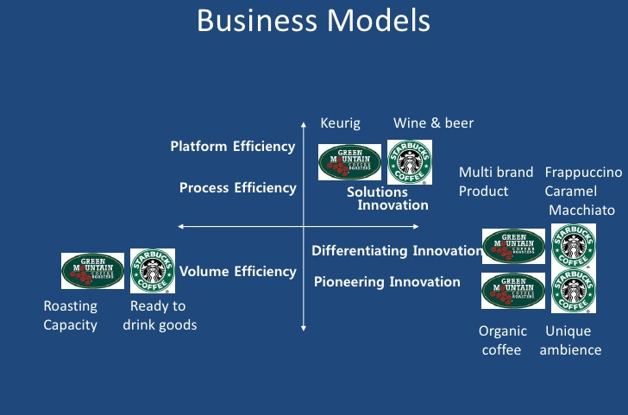
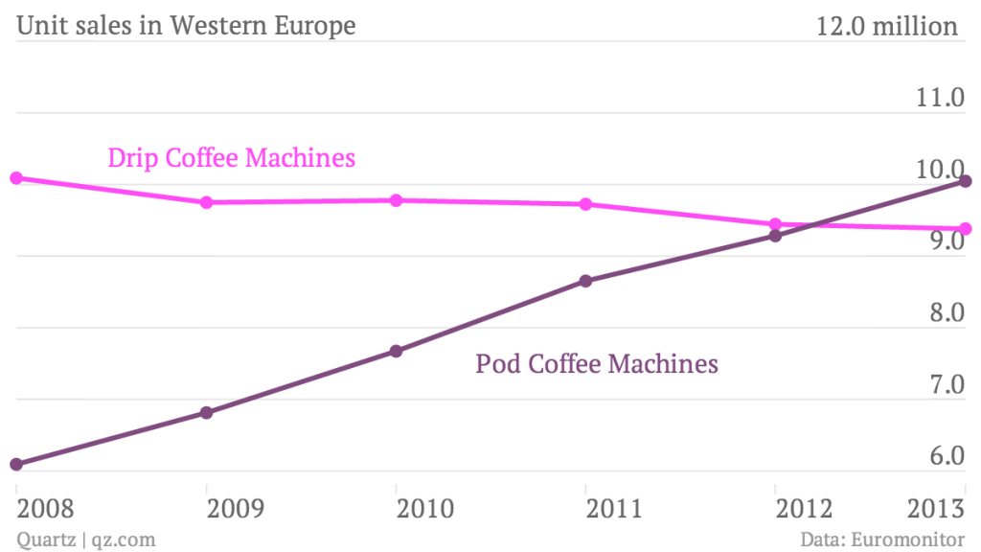
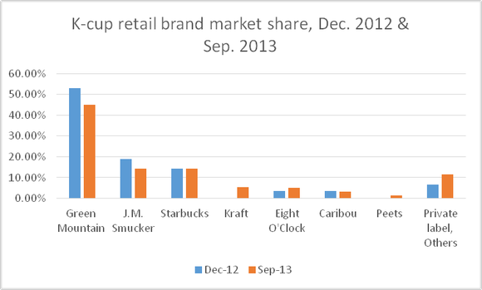
Keurig business model aims to drive efficiency through continual innovation in all sectors of coffee industry – product, packaging, supply chain etc.
It doesn’t compete head-on with competitors but assists in making K-Cups for them. Keurig doesn’t aim to open café‘ s like its competitors but wishes to provide gourmet coffee right inside office buildings.
“The expert in battle moves the enemy and is not moved by him”
Sun Tzu, The Art of War

Slide 15
Creating a Fantastic Product which is the Keurig Single Brewer Coffee Machine Machine gave Keurig the ‘room’ to test new ideas in other segments of industry –
Product
Packaging,
Supply Chain
Sustainability
Internal Value Chain –
employees, skills, infrastructure
The Innovations in Other Areas – Would be Discussed in Future Slides
Innovation in this segment and following success
gave the ‘room’ to Test New Ideas in other segments and thus increasing overall dominance in the coffee industry

Slide 16
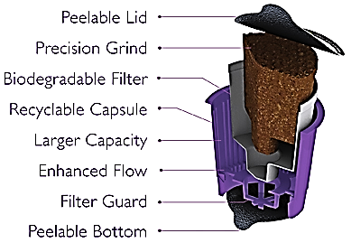
Relationship Matrix Hypothesis of Innovation Creation due to
Packaging Nested Packaging (Reducing the Size of K-Cup Portion Packs to Eliminate Environmental Waste) “My K-Cup” - a reusable filter assembly reducing waste | Structure
 | Special Coffee Business Unit: responsible for reducing energy use and waste reduction Sustainable engineering design and established in-house Life-Cycle Analysis
 | Drivers
 | Most significant environmental impact actually occurs in the production of the materials used to create the product Invented 1st hot to-go beverage cup and lid made with renewable materials. All the packaging film for bags is made with 19.4% PLA, a natural renewable biopolymer.
 | Strategies
 | Nested packaging for K-Cups, which reduces distribution-related greenhouse gas emissions by over 20%. Also, delivers a +90% reduction in transportation and warehousing costs when compared to loose packaging used by Starbucks & Nespresso Keurig components are free of Bisphenol-A (BPA-pollutant)
 | Method
 | System Engineering Approach to Packaging Line: life-cycle process intended to satisfy the requirements of the functional architecture and the requirements baseline Upstream Logistics Downstream Logistics
Process : Manufacturing container
Packaging: K-Cup manufacturing
Secondary Packaging: packaging K-Cup packs for distribution/sale
Conveyor and line regulation

Slide 17
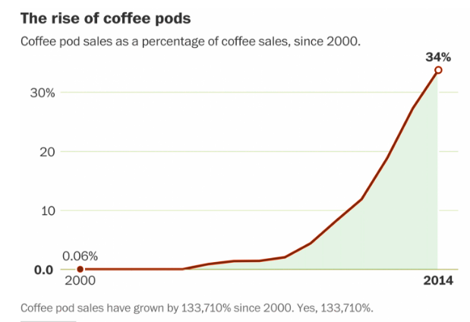
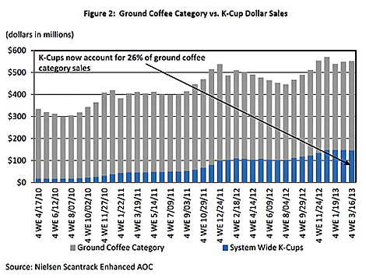
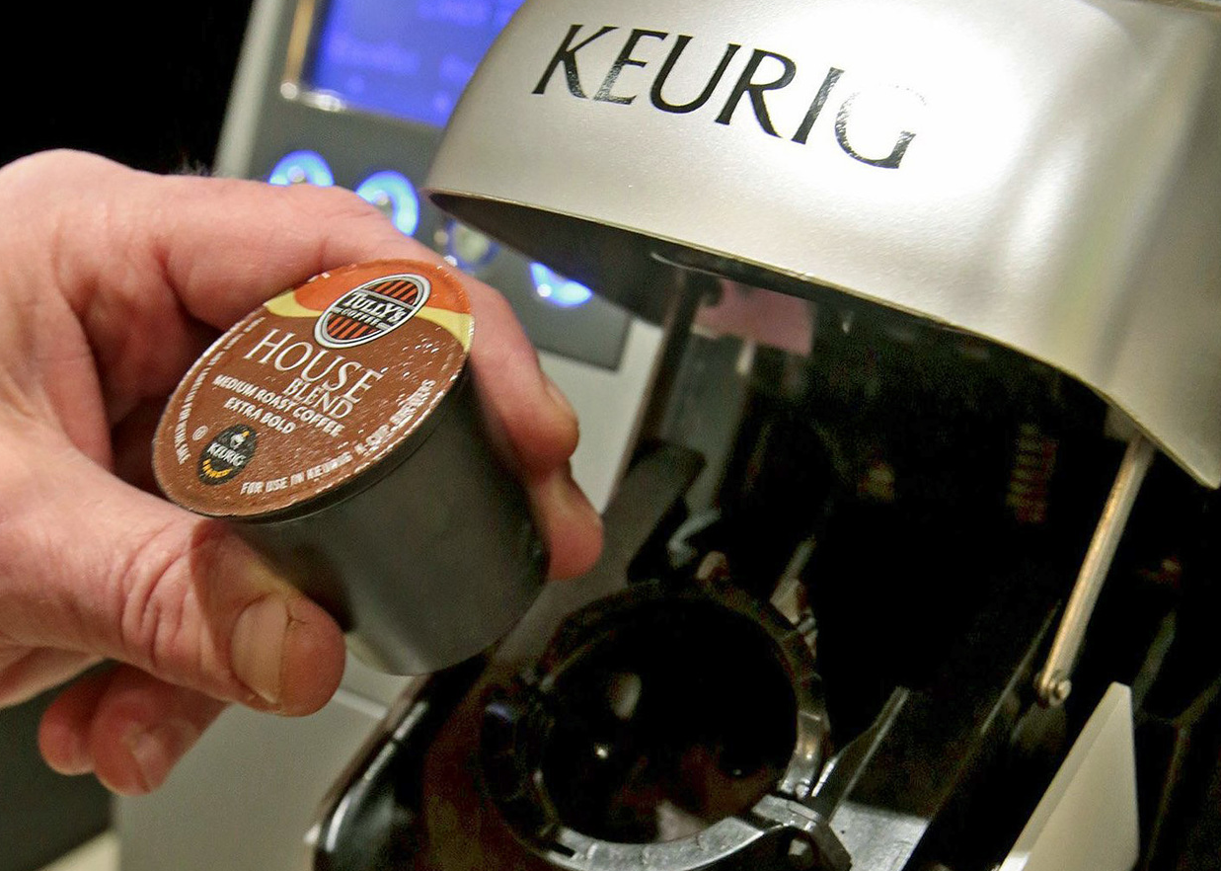
Keurig K Cup taking over the market since their invention in 1997
Replacing traditional brewing technologies of drip coffee which used grounded coffee

Slide 18
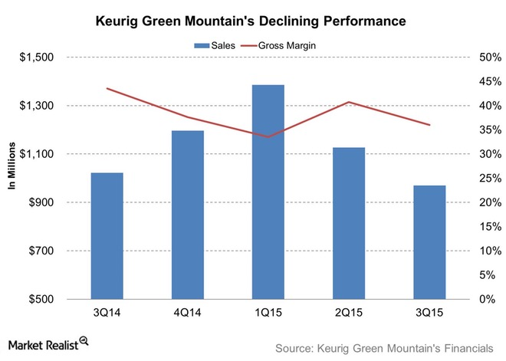
Innovation 2
Recyclable K-Cups
After huge success from 2002 – 2009 K Cups Posed Environmental Problem
In 2013, Keurig Green Mountain produced 8.3 billion K-Cups — enough to circle the Earth 10.5 times. (In 2014, output shot up to 9.8 billion portion packs.)
Decreasing Keurig Sales : Article in Huffington Post on May 16, 2011

Slide 19
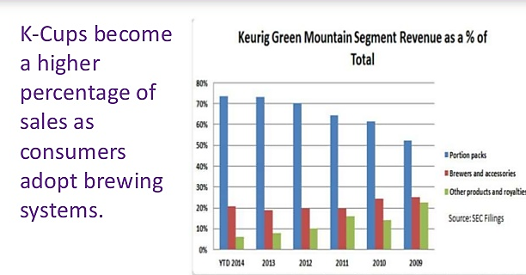
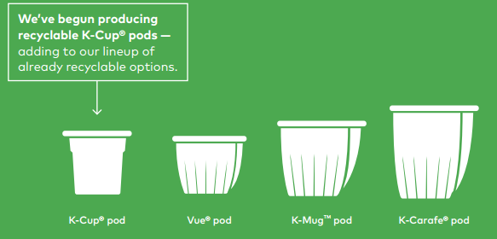
Keurig Invested in Innovation and grasped the opportunity for dominance AGAIN
In 2015 collaborated with Resource Recycling Systems (RRS) to run tests in three different U.S. communities.
Method & Results:
Mixed the cups with about 70 tons of incoming recyclable material at each of the three MRFs, and ran the equipment for about two hours in order to process all 70 tons.
K-cups passed initial screening deeming fit to be sold out in public.
In the midst of chaos, there is also opportunity
The Art of War by Sun Tzu
Keurig Invented A Whole Line-up of Recyclable K-Cup options in 2015

Slide 20
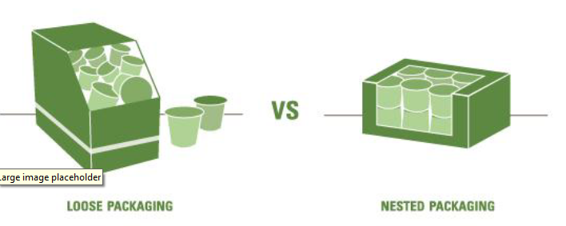
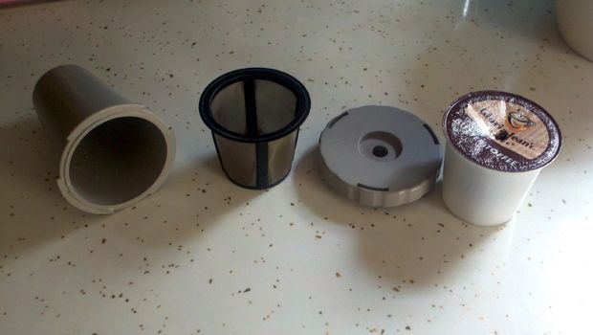
Innovation 3
Nested Packaging v/s Loose Packaging :
By introducing “nested” packaging for 12, 16, 18 count K-Cup packs as well as 12 and 16 count Vue packs reduced packaging size by 30% and decreased shipping-related greenhouse gas emissions by 20% as compared to loose fill.
Renewable polymer from natural corn-starches used in packaging film for 10 and 12-ounce bagged coffees for the Green Mountain Coffee®, Newman’s Own® Organics, and Tully’s Coffee® brands.
The My K-Cup® assembled cup is a reusable filter assembly that we designed to be easily cleaned, refilled, and placed into home K-Cup® brewing systems.
“My K-Cup” assembly

Slide 21
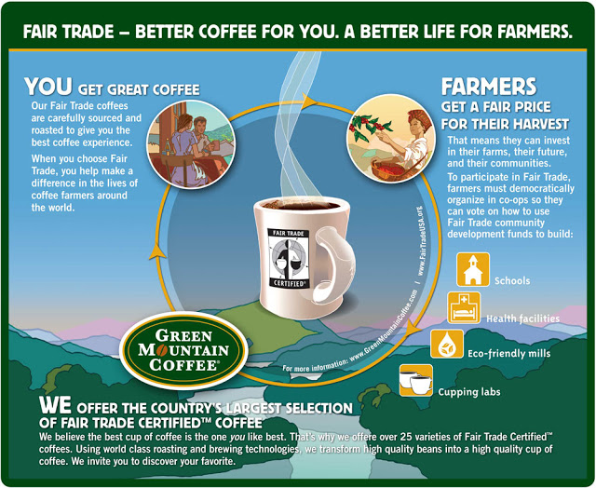
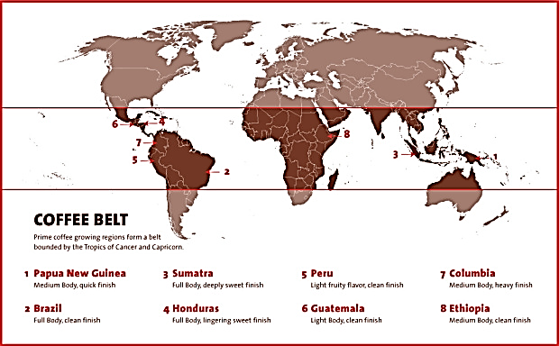
Innovation 4
Innovation in Supply Chain- Farm ID program
Know who produces coffee, and how they produce it, to make more informed purchasing decisions.
Keurig procures coffee from all continents of the ‘Bean Belt’ except South East Asian Countries & Australia.
The Bean Belt : generally coffee is grouped into three major growing areas: the Americas, Africa, and Asia, within 1,000 miles of the equator.

Slide 22
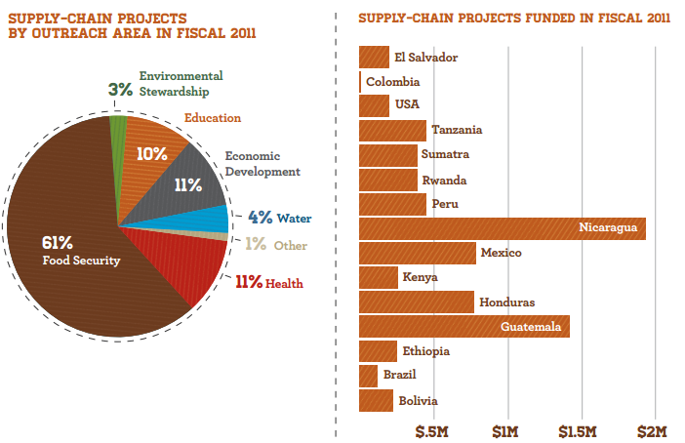
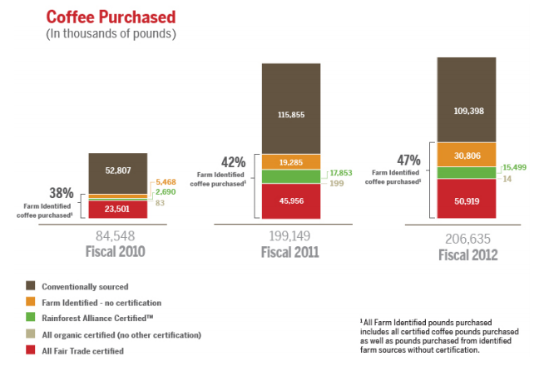
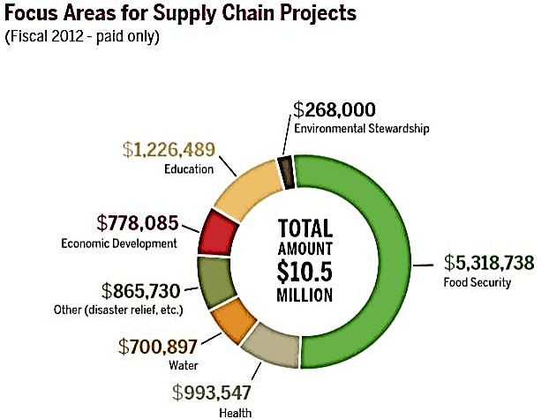
Keurig Farm Id Program compared to conventional sourcing
Who Produces The Coffee & How its Produced to make Informed Decisions
Know yourself and you will win all battles
-”The Art of War” by Sun Tzu

Slide 23
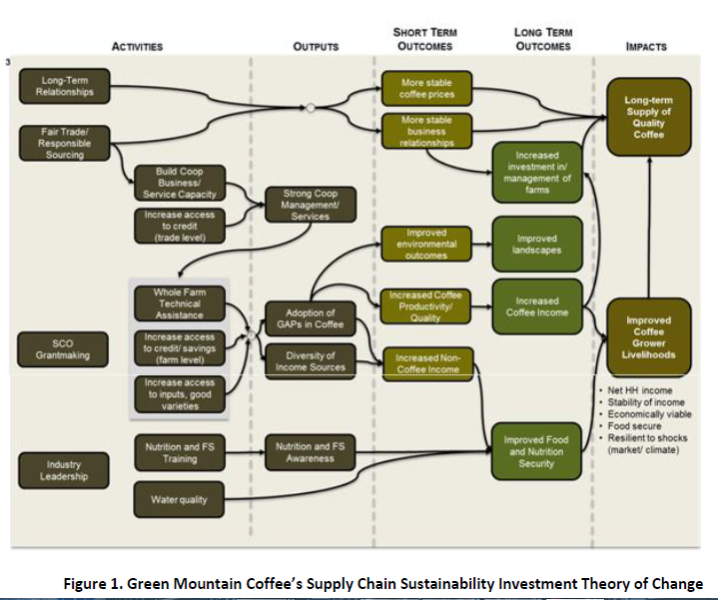
Towards 2nd part of Hypothesis – improvements in internal value chain –farmers, training, technology, etc.
KGM’s Theory of Change Methodology
A visual representation of the company’s theories around how their supply chain projects and investments achieve their strategic sustainability goals.
A set of hypotheses, working left to right from investment activities to outputs to outcomes and impacts.
Highlighted set of hypotheses in “Theory of Change”
Notes:
There is not much statistical evidence for hypothesis 2 since the methodology is in a preliminary stage . The presentation slides 22-30 is based on similar methodologies adopted in coffee and dairy industry else where and assumptions made by Keurig in its Sustainability report 2016.
The majority of their work on certification shows that the programs do not do enough to support the farmers and improve their livelihoods or the environment.
The most informative part of this document is the “Impacts” section since it defines KGM’s continuing goals: Long-term Supply of Quality Coffee and Improved Coffee Grower Livelihoods. The latter explains how they see their investments affecting the farmers and the long term benefits to the coffee-growers they source from.
Is there evidence to Support Keurig Green Mountain’s Livelihoods Theory of Change?
Keurig Green Mountain makes significant investments into their coffee supply chain with the intended dual purpose of improving the livelihoods of the farmers who grow the coffee and stabilizing the long-term supply of quality product available to Keurig.

Slide 24

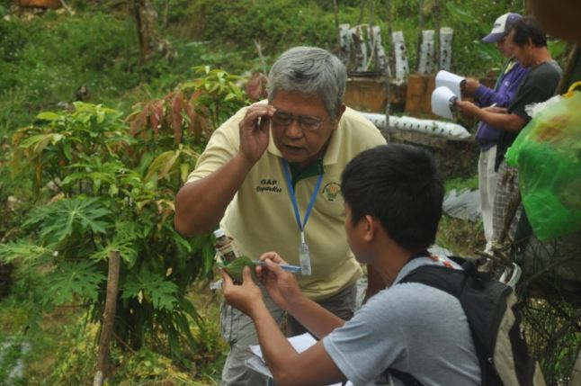

Keurig Postulates
Coffee farmers adopting Good Agricultural Practices (GAPs).
Grant making for a non-profit or NGO would provide
technical assistance to farmers
increased farmers’ income
increased investment in the management of their farms
increased coffee productivity and/or quality
Treat your men as your beloved sons, and they will follow you into the deepest valley
‘The Art of War’ by Sun Tzu
Achieve one of its two over-arching goals—a long term supply of coffee
Notes:
Points to investigate:
1) Does increased productivity and/or quality lead to increased income?
2) Will increased investment in the farm associated with the original technical assistance lead to a long-term supply of quality coffee for KGM?

Slide 25
Conducting Further Investigation
Gauging Keurig’s “theory of change”
Improved Livelihoods
Long-term Supply of Quality Coffee
Income Security
Quality
Extension Services
Certification
Quality
Environmental Sustainability
Producer Groups/Rural Enterprises
Productivity
Rural Enterprises
Migration
Food Security, Health and Nutrition, and Water Security
Nutrition and Health Security
Food Security, Nutrition, and Farmer Productivity
Creating Food Security through Income Security
Water
Notes:
In order to support the link between improving livelihoods and long-term supply of quality coffee, the link between farmer health and farm yields was investigated as a first step. Inherent in this search was an assumption that better yields lead to a more stable supply for the buyer, Keurig Green Mountain.

Slide 26
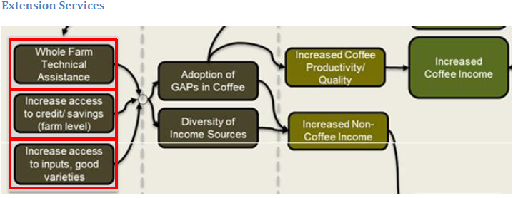
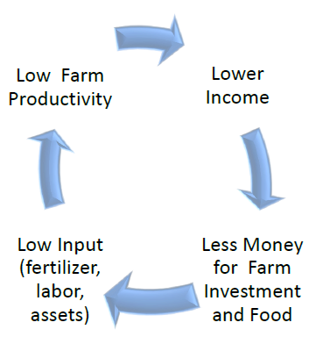
Conducting Further Investigation
Keurig’s “theory of change”
Access to Inputs
Microfinance
Business Skills Training
Technical Assistance
Improved Livelihoods
Income Security
Extension Services
Certification
Quality
Environmental Sustainability
Producer Groups/Rural Enterprises
Certification group commissioned
Positive to Mixed Results Studies
Mixed to Negative Results studies
To be discussed in detail
Keurig trying to break “vicious circle” with income security

Slide 27
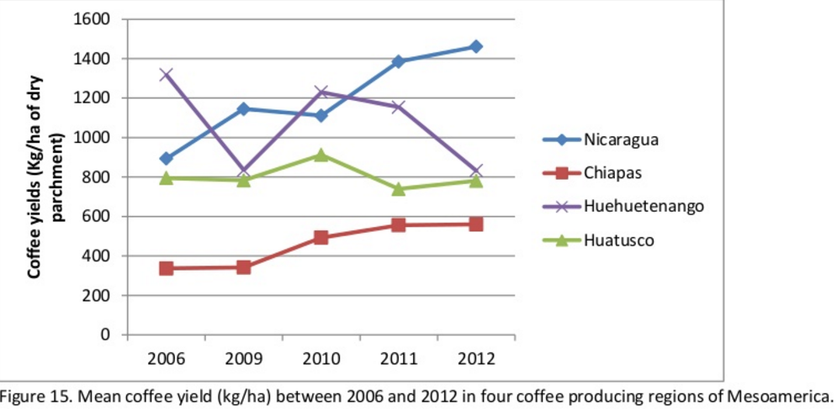
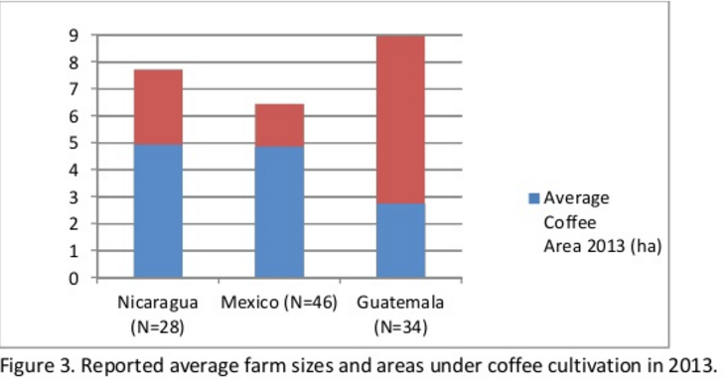
Extension Services
Impact of ‘Theory Of Change’
Access to Inputs
Adoption of GAPs : like hybrid seeds and Giving farmers access to credit.
Increasing in productivity & Quality
Empowering smallholder farmers to gain access to credit on their own, and reinvesting micro-credit into farms
Increased investment in farms
Microfinance
Business Skills Training
Enabling farmers to both manage their farms and demand a better price for their product
Improved Livelihood
Technical Assistance
Monitoring farmers creditworthiness, and tracking farmers’ willingness to pay
Increased Income Security

Slide 28
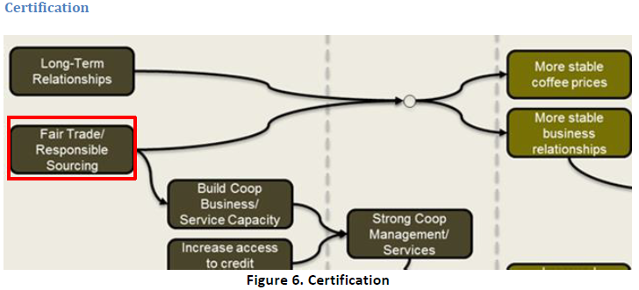
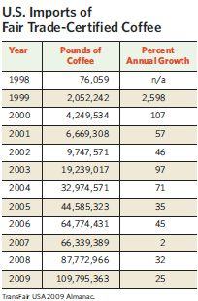
Certification
Not much statistical evidence on how ‘Certification’ is helping farmers improve their livelihood
Certification Group Commissioned
Coffee certification programs such as Fairtrade International Rainforest Alliance
And
Responsible sourcing guidelines which provide : fair wages, no forced or child labor etc.
Shared Value Across Supply Chain
Only 50% effective : Certification could provide opportunities for farm and livelihood betterment
True change only comes from a more wholescale approach to improving livelihoods.
Positive to Mixed Result Studies
Less Than 50% effective : Certifications or responsible sourcing guidelines, are not enough to guarantee any kind of income security or livelihood improvements
A diversified, multifaceted strategy on improving livelihoods is critical.
Mixed to Negative Result Studies
% annual growth in imports is not increasing
Notes:
Though the Theory of Change was a great step forward in explaining the ways in which the company’s investments led to stable supply and improved livelihoods, it was still only a theory

Slide 29
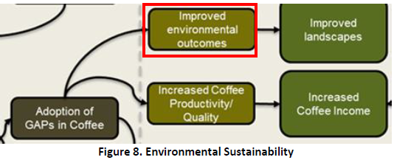
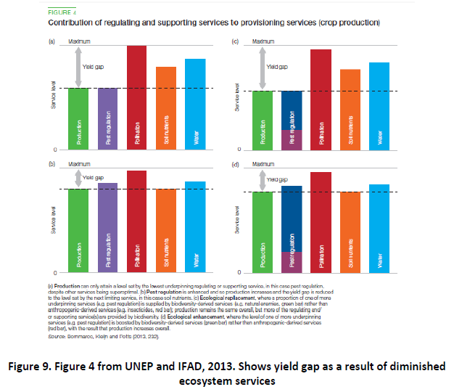
Environmental Sustainability
A ‘yield gap’ - the difference between potential and actual yield - widens as the provisioning of ecosystem services diminishes, e.g. lack of water, lack or imbalance of nutrients, pest damage, weed competition and lack of pollination.
The necessary investment to close this yield gap through inputs, such as (artificial) fertilizers and pesticides, increases as ecosystem services decline
Decreased Yield Gap
Adoption of GAPs leads to both better environmental outcomes and increased productivity/income security.

Slide 30
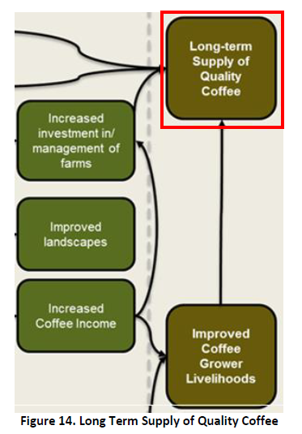
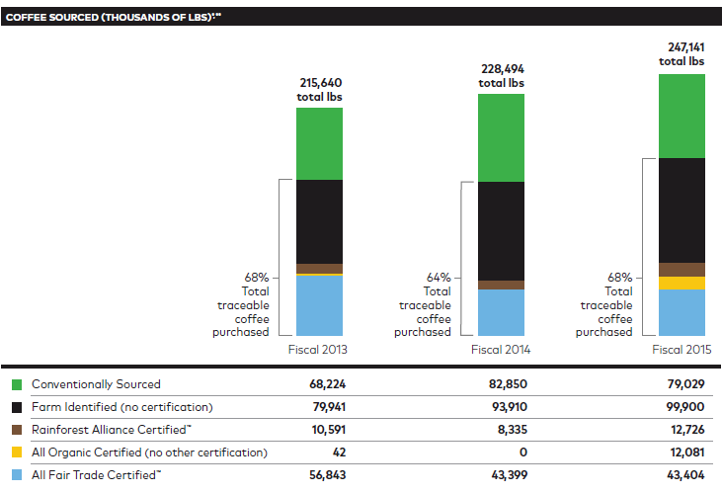
Keurig’s “theory of change”
Long-term Supply of Quality Coffee
Encouraging farmers & cooperatives to adopt quality-increasing practices and consistent purchase of higher-quality beans.
supply chain and farm-level investments increasing the quality of the product.
Quality
Go beyond subsistence farming Business development training to increase the efficiency of operations
Productivity
Heightened levels of productivity allow increased coffee income
Through these orgs. Farmers disseminate best practices for farm management, increase quality, and streamline practices to lower operating costs.
Farming cooperatives increase operational efficiency, lead to easier standardization of quality. and more traceability at the farm level.
Rural Enterprises
Migration
Decreasing vulnerability in the securities (income, food, health) to slow migration away from the farming area.
Hypothetically holds true.
Notes:
There were no case or statistical studies done on investments in farming livelihoods that led to improved long-term outcomes for the company. This ppt attempts to prove as many of the Theory of Change links with evidence from available literature. This section will use the findings described in earlier sections of this paper to determine the ultimate benefits to KGM through the long-term supply of quality coffee.

Slide 31
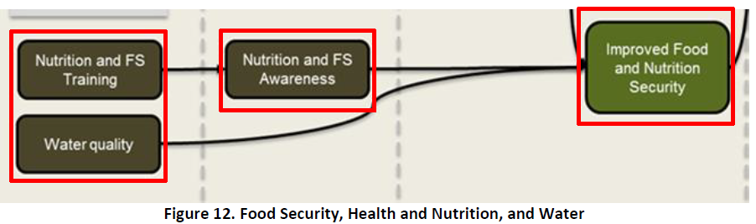
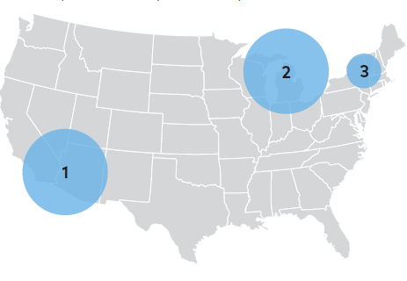
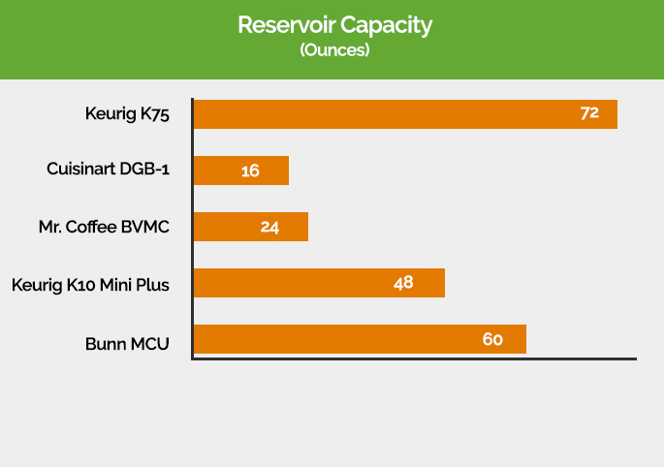
Keurig’s “theory of change”
Improved Livelihoods
Water Security: Water Stewardship Projects
3 areas of action:
Balancing, restore equal volume of water for nature
Connecting people to clean water,
Optimizing resources through efficient
use of water in supply chain.
Restore rivers & protect clean drinking water
Colorado River Delta: balancing 524 million gallons of water/year.
Great Lakes Region: focus on water quality improvements
Lake Champlain: improving water quality
Collaboration with Nature Conservancy
in 2015
Smart Water Use in Keurig Products
The Keurig® brewing system uses water from the tap and only the amount that will be consumed as part of the beverage prepared.
When one treats people with benevolence and reposes confidence in them, the army will be united in mind and all will be happy to serve their leaders. – ‘The Art of War’ by Sun Tzu

Slide 32
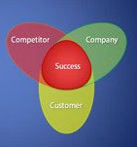
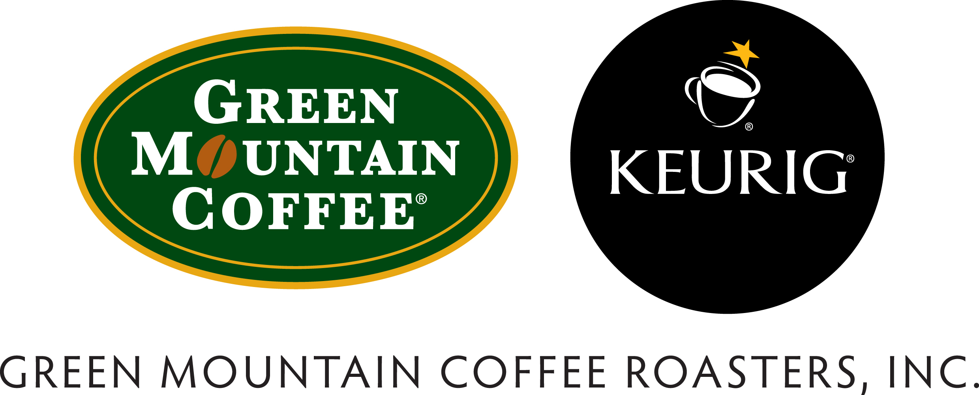
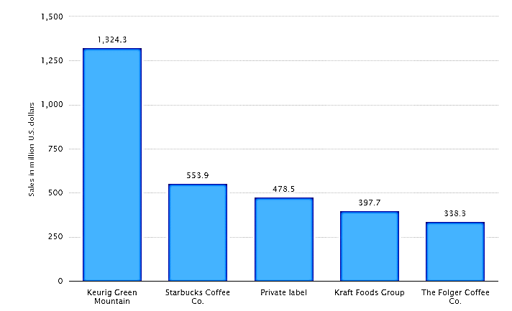
Ohmae’s 3 C’s
Company : Keurig Green Mountain Inc.
Exceptional Product: Keurig® brewers in more than 20 million homes & offices
Consistent and Convenient: In under a minute deliver a
fresh-brewed, great tasting cup. As a testament to
that quality, more than 50 leading global coffee, tea
and cocoa brands have partnered to offer
consumers 500+ varieties.
Sustainable Farming: Socially responsible, resilient
supply chains, promoting thriving coffee
farming communities.

Slide 33
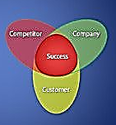
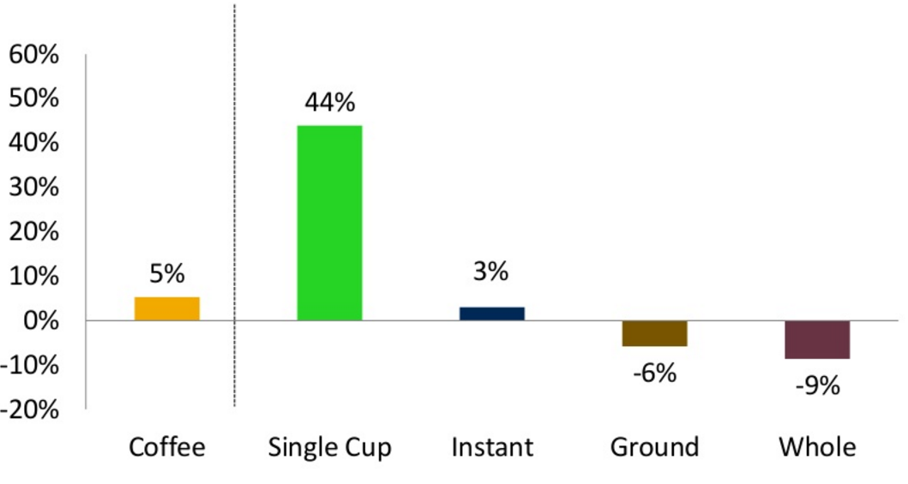

Ohmae’s 3 C’s
Customer:
Target Market and Segmentation –
54 % Americans Drink Coffee (also named ‘Elixir’ in Greek Mythology)
Middle to Upper Class (drinkers spend $117.7/month on daily 16oz coffee.)
Home & Office User
45 % growth from 2011-2015 in single cup coffee customers
8% reduction for grounded/bagged coffee bean customers
44 % Customers choose single cup brewing systems over other categories

Slide 34



Ohmae’s 3 C’s
Customer
Real Consumer Feedback: Purdue University, Industrial Engineering Dept. Kitchen 2nd floor
1. 90% of the students(above age 24) confess to not think about preparing a coffee at home because K-Cup & Keurig brewer is consistent in brewing quality coffee
2. 95% of students say that they would recommend the Brewer to a friend i.e. loyalty for the brand
3. 85% feedback with common theme “Freshness & taste drive instant satisfaction”
4. 12% suggest that it has changed the way people view coffee machines, no more grinding beans, measuring water & cleaning soggy filters.
5. With Keurig Cup costing only $0.6-0.8/cup, it is easier to brew better coffee with a K-cup instead of waiting time in a Starbucks line

Slide 35


Keurig Brewers Skew to Higher Income Demographics
Primary Audience
Adults ranging from 18-24 (MRI index: 82), currently going office, college and always on the go. They love to drink coffee and have a strong sense of responsibility & maturity.
Secondary Audience
Adults aging from 55-64 (MRI Index:133) ears old who are parents/grandparents of the new audience, gross over $ 150,000 annually, and are able to afford and provide a luxurious and high end lifestyle.
Coffee Consumption within Keurig Households

Slide 36


Competition
Ohmae’s 3 C’s
Low barriers to entry encouraged new competitors that brewed coffee packaged in non-patented pods
Many current & potential competitors had substantially greater financial, marketing, and operating resources than Keurig such as Nestle(Nespresso), Starbucks, Kraft(Tassimo) & Mars(Flavia)
But Keurig Solved Consumer problems by inventing Keurig 2.0 which is
Convenient, low mess, fast, reduces waste
brand variety, consistent taste
Continual Innovation in all segments is the Key Factor for Success

Slide 37


Competitor Profile #1 in Pod Brewing Systems
Nestle, which has a 35% global share of the single-serve market, has only tiny presence in North America eyeing for bigger share.
North America is the 2nd largest market in the $8billion single-serve market
Nestle dominates the European market with a commanding 70% share.
In 2013, Keurig did approximately 92% of its sales through the combination of portion packs and Keurig Single Cup brewers and related accessories. The company had $4.3 billion in total sales coming from Keurig Single Cup Brewer from the United States and Canada.
Whereas
Nespresso only does $300 million in sales of coffee pods/capsules and brewing systems
Thus proving the hypothesis that continual innovation over all categories sustains the blows of competitors.
Shaping The Opponent : Employing the Strategy to Master the Competition
-Sun Tzu The Art of War

Slide 38
Keurig Economics
Brewer :
Brewer Cost:
Single K-Cup cost
Added Coffee Costs(later)
Savings/day for period of 30 days
Proprietary K Cups
Cost of Coffee(Verona brand)
Cost per cup
Keurig | Starbucks
Keurig 2.0 (invented 2015) | Verismo
$119 | $249
$0.53 | Not Produce
None, ‘My K-Cup’ assembly, no filter required later Investment compounds savings every year | Not reusable, long queues in Starbucks café Initial investment costly
$1.25/day ($456 a year) for a 10 ounce cup | $0.35/day($273 a year) for a 10 ounce cup
K-Cups which only work in Keurig machines thus driving continuous sales | Depends on Keurig for K-cups for Verismo
$37.99 for 96 K-cup portion pack | $67.98 for a 96 K-cup portion pack
$0.33/cup | $0.65/cup
Basic Assumptions
Cups of Coffee/day | 3
Life of coffee maker(yrs) | 5
Cups of coffee total | 5475

Slide 39


Porter 5 forces - Analysis
Bargaining Power of Suppliers
Supplier Power With Responsible Sourcing Guidelines which includes:
Uniqueness of Service Signature offerings: Single-cup brewing system Sealed “K-Cup” packs of coffee, Regular third-party validation is a key part of ensuring compliance. Aggressive in hitting key areas for environment protection: Achieve zero waste-to-landfill distribution facilities Reduced greenhouse gas emissions by 25 percent compared with 2009. Minimize the use of water and results in little or no waste. World’s largest purchaser of Fair Trade Coffee Balances Social Responsibility 837,000 people received support through company-funded partner projects. Sustainability journey holistically involves largest retailer to the smallest farmer.
International Labor Organization (ILO) Recommendations
Fairtrade Labeling Organizations International (FLO) Standards
Rotterdam Convention on Persistent Organic Pollutants.
Know the Enemy & Know Yourself
Sun Tzu The Art Of War

Slide 40



Porter 5 forces - Analysis
Bargaining Power of Buyers
Low – The switching costs for Keurig Brewers in Offices and homes with Nestle Nespresso or Starbucks Verismo is high(their price is 1.5-2 times) Keurig uses innovative techniques focused on driving maximum customers: Seasonal Campaigning - Mails with Keurig Portion packs Utilizing the Psychological Principles of Persuasion – Reciprocity & Liking, Halo Effect At Thanksgiving 2015, sent out 125,000 pieces, urging to either try or give as gifts
Threat of Entrants
Low – With continual innovation strategy in all sectors of coffee industry, resilient supply chain, product or packaging, Keurig has a stable economy, 14 patents which prove its specialized knowledge. No Barriers to Entry other than regular cafés Starbucks has cafés but earns no significant profit through office brewing systems

Slide 41




Porter 5 forces - Analysis
Competitive Rivalry
High –Strong competitors like Starbucks & Nespresso but with continual innovation in other sectors of coffee industry Keurig has greatly reduced the threat of substitution. Substitutes to Coffee: tea, energy drinks but fulfills fewer needs. Americans understand the benefits of coffee – enhanced mental cognition, longevity, and its nootropic benefits when it comes to performance under high stress which tea and energy drinks can’t substitute. Energy drinks are not natural and contains added sugars: contain artificial caffeine whereas coffee has natural caffeine in higher content More than just coffee: Keurig products are eco-friendly and yearly investments on social responsibility projects are more than its competitors which promotes its values and lures customers to support the cause.

Slide 42

Conclusions
1st part of the hypothesis
Substantially proved
Keurig has made continual innovations in all segments of coffee industry, the whole value chain from product ,to packaging to supply chain to end-of-life recycling.
Not Enough Evidence for whether improvements in Internal Value Chain – farmers, infrastructure, sustainability etc. can give a competitive advantage on revenue and thus give ‘room’ to test more ideas
“Theory of Change” Methodology is only partially proved
From the data present, it can be said that Keurig has respected the farming communities with empowering them business training, co-operatives, water stewardship programs but there is not much statistical evidence on how procurement from certified farms is helping with long term supply of quality coffee certification.

Slide 43

Future Strategic Consideration in Global Coffee Demand
Key Coffee Market Drivers:
Growing Demand in Emerging Markets :
Emerging markets to reach global coffee consumption by 2020
Growth in instant coffee driven largely by emerging consumers
Regional differences in retail coffee value and volume
North America continues to lead both value and volume of coffee sales so focus to be directed on West.
3. Premiumization
Growth focused on differentiation and quality of gourmet coffee
Premium offerings must be supported by Fair Trade, organic and original
4. Product Innovation
Innovation driving market share gains and gross profits
Consumer preference for quality innovation & seamless user experience
5. Growing out-of-home offering
Consumers willing to pay more for convenience
Replacing ground cafe shops with quick service specialty coffee restaurants (QSR)

Slide 44
Appendix
Important Changes In Slide 11 and 15
1) Definition of success and values in the case study – ……………….…………………………………………………………………Slide 41
2) List of hypothesis (causes and innovations). ……………………………………………………………………………………………….Slide 6-21
3) For each innovation, list the slide numbers ………………………………………………………….........Slide 12,13,16,17, 18,19, 20,21
4) List the hypothesis that you have proved convincingly
1st part of hypothesis
Company must make continuous improvements in all segments of its chosen industry
5) List the hypothesis you have not proved convincingly.
2nd part of hypothesis
Structured investments in supply chain projects lead to beneficial outcomes such as improved yield and eventually to the desired impacts of improved farmer livelihoods.
Not much statistical evidence for slide 26 & 29

Slide 45

References:

Slide 46
References :
http://www.newsweek.com/green-2015/top-green-companies-u.s.-2015
https://qz.com/207354/america-loves-k-cups-but-instant-coffee-rules-the-world/
Sustainability Report 2012 (for details on customers)
for Customer profile :
https://www.experian.com/blogs/marketing-forward/2009/12/01/demographic-and-preferences-of-coffee-drinkers-in-america/
http://archive.boston.com/business/articles/2011/08/07/the_inside_story_of_keurigs_rise_to_a_billion_dollar_coffee_empire/?page=3
Sustainability Reports of Keurig Green Mountain of Year 2012, 2013, 2014 Part A
Corporate Social Responsibility reports of Keurig of year 2012, 2013, 2014 part B
Keurig 4th quarter reports for fiscal year 2015
Keurig press releases from 2014 October – January 2015
https://www.theguardian.com/sustainable-business/2015/may/27/nespresso-sustainability-transparency-recycling-coffee-pods-values-aluminum
https://www.starbucks.com/responsibility/environment/recycling
Preliminary list of literature material which would be reviewed are:
Pod adapter for use with k-cup™ beverage brewer US 20130199379 A1
Re-usable beverage filter cartridge US 6658989 B2
Single-serve beverage production machine US 20150257586 A1
Beverage cartridge US D647398 S1
Portable coffee maker US 4382402 A
Disposable single serve beverage filter cartridge US 6607762 B2
Beverage forming device and method with moving beverage cartridge holder US 20140338542 A1

